Slide 1

NCRTC Bus Management System
Fleet Management Platform for NCR Transport Corporation
FLEET MANAGEMENT
FULL-STACK PLATFORM
CAPSTONE PROJECT

Slide 2
Problem Statement & Our Solution
The Challenge
Our Solution
Hundreds of feeder buses across Delhi-NCR with no centralized visibility
Paper-based duty assignments causing delays and errors
Incident reporting via phone calls — no audit trail
No real-time operational dashboard for controllers
A full-stack Bus Management System delivering four integrated modules:
AVLS
Scheduling
Live vehicle tracking
Duty management
IMS
CMS
Incident response
Driver communication

Slide 3


System Architecture
Database & Telemetry
PostgreSQL + PostGIS with GPS tick simulator
Backend
FastAPI handling WebSocket and APIs
Frontend
React + Vite SPA and Driver PWA
A unified monolithic architecture ensures faster delivery, a shared database, and real-time vehicle tracking — all deployed as a single unit for operational simplicity.
Frontend
Backend
React + Vite SPA with a shared Driver PWA codebase
FastAPI REST API with WebSocket + polling fallback
Database
Simulator
PostgreSQL + PostGIS for spatial GPS data
GPS Tick Script generating live vehicle pings

Slide 4

Data Model & Security
Core Database Entities
Security Architecture
01
JWT Authentication
bcrypt Hashing
Depot & Vehicle
Stateless token-based sessions
Secure password storage
Fleet inventory and depot hierarchy
02
GPS Ping
5 User Roles
Service-layer Auth
Timestamped location records with PostGIS
Granular depot-level access control
Authorization enforced at business logic level
03
User & Duty
Driver profiles, roles, and roster assignments
04
Incident & Event
Full lifecycle audit trail
05
Notice & Read Receipt
Targeted communication tracking

Slide 5
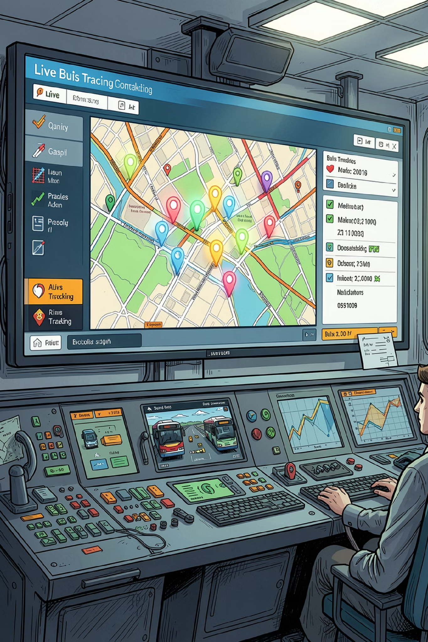
Module 1 — AVLS: Live Tracking
Real-Time Map
Moving bus markers with route trail visualization and vehicle detail panels
Historical Playback
Replay past trips with timestamped GPS ping data
Optimized Queries
Composite PostGIS indexes on GPS data for sub-second lookups
Resilient Delivery
WebSocket updates with automatic polling fallback for unreliable networks

Slide 6
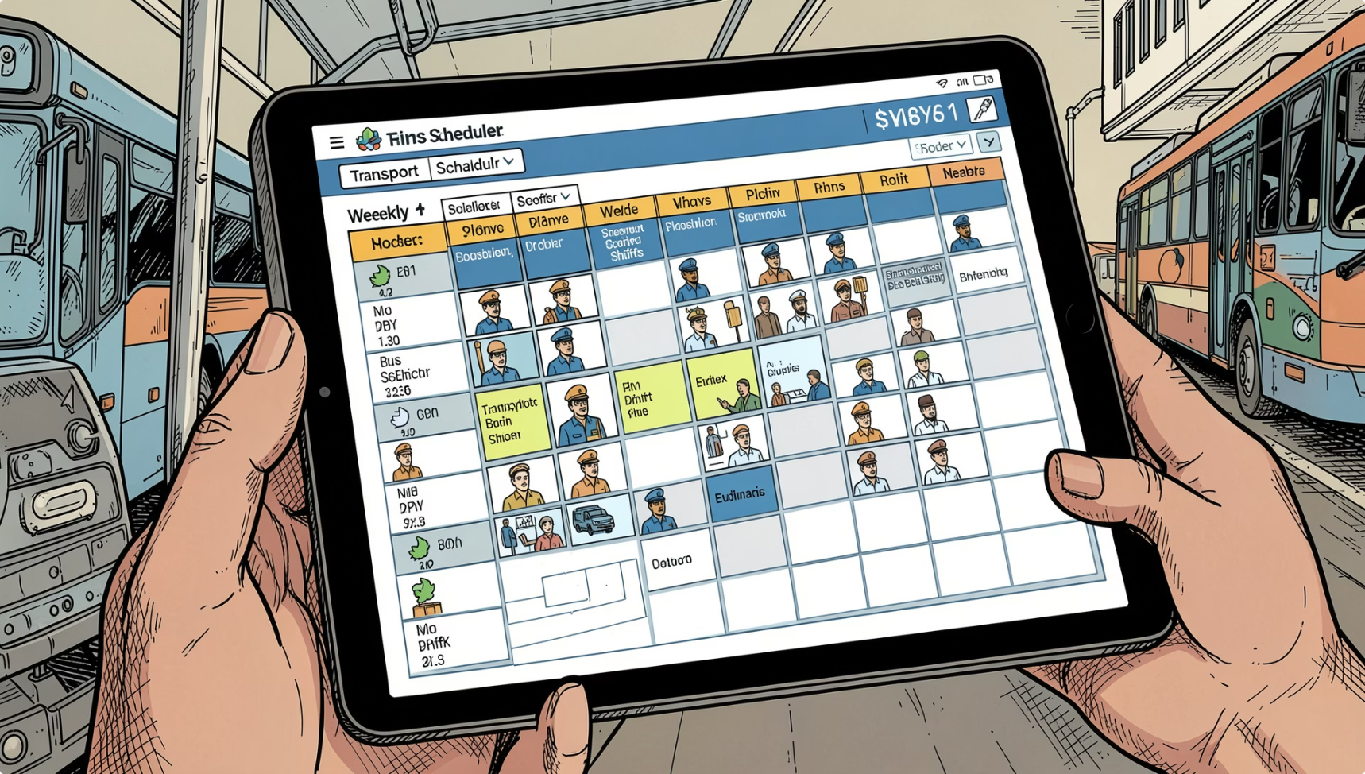



Module 2 — Scheduling & Duty Management
Roster Workflow
Key Features
Color-coded roster grid for quick visual scanning
Assignment management with conflict detection
Driver self-service dashboard for duty acknowledgement
Draft
Planner builds weekly roster grid
Published
Roster released to all drivers
Acknowledged
Drivers confirm via self-service portal

Slide 7
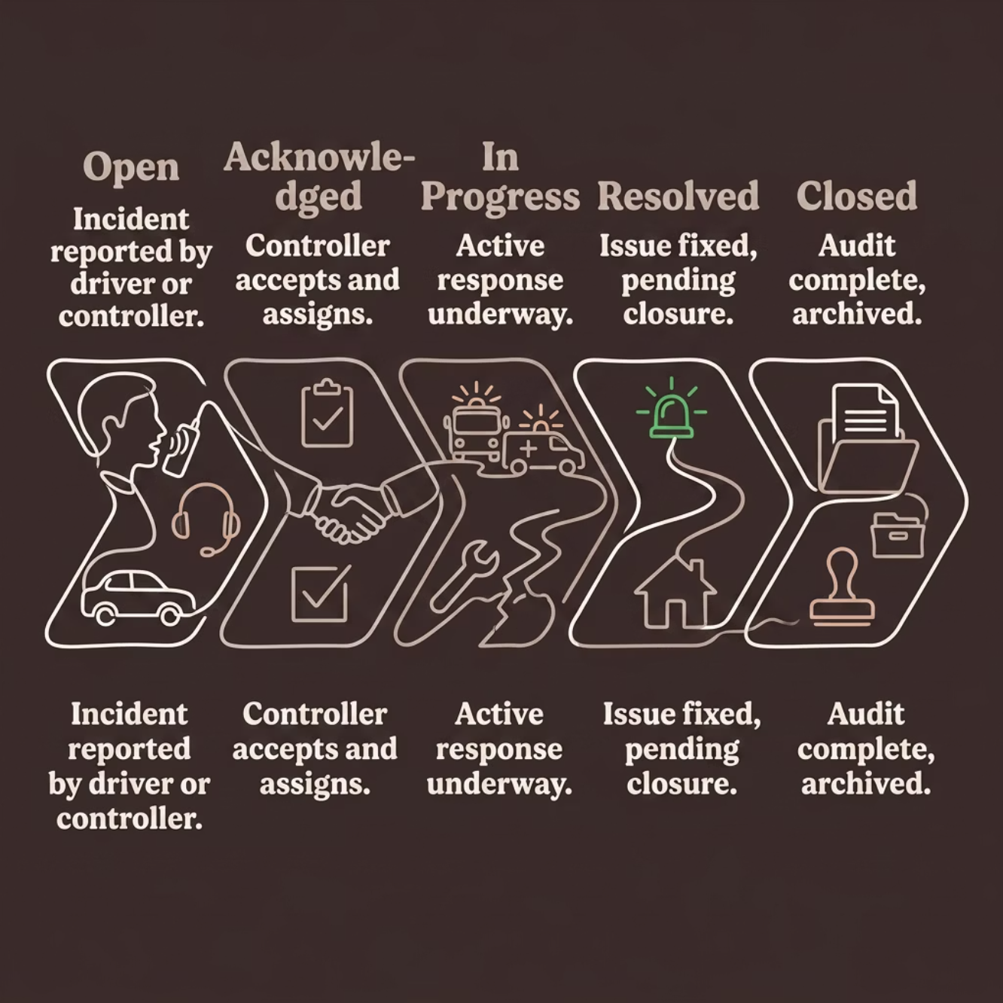
Module 3 — Incident Management (IMS)
Incident State Machine
SLA Targets
Core Capabilities
Driver panic button for instant alerts
Full audit timeline with event log
SLA monitoring with breach alerts
P1 Critical
P2 High
P3 Standard
60 min response
4 hr response
24 hr response

Slide 8
Module 4 — CMS & Testing
Content Management System
Testing & CI Pipeline
Targeted notices with read receipt tracking ensure critical messages reach the right personnel.
~70 Automated Tests
Covering auth, AVLS, scheduling, incident lifecycle, and security
GitHub Actions CI
Automated pipeline on every commit and pull request
All Users
By Depot
By Role
Fleet-wide announcements
Location-specific alerts
Role-targeted notices

Slide 9
Key Architectural Decisions
Decision
Choice
Rationale
Architecture
Monolith
Faster delivery, shared database
Communication
WebSocket + Polling
Real-time with reliability fallback
Frontend
React + Vite
Rapid development, rich ecosystem
Driver Portal
Same Codebase
Lower maintenance overhead
Incident Workflow
State Machine
Full auditability and data integrity
Composite Indexes
PostGIS Spatial
Shared Frontend
Optimized GPS tracking queries
Native geographic data support
Single codebase for web and PWA

Slide 10


Limitations & Future Roadmap
Current Limitations
Future Enhancements
GPS data is simulated — no live vehicle integration
Redis integrated but not actively used in production
SQLite in tests, PostgreSQL in production — environment mismatch
No incident image upload support
Real GPS Integration
MQTT/TCP ingestion from live vehicle hardware
Token Refresh + Redis
JWT blacklist for secure session management
S3 Photo Uploads
Incident evidence capture and storage
AWS Cloud Deployment
ECS + RDS + CloudFront for production scale
Conclusion: A scalable, secure, and modular fleet management platform — covering tracking, scheduling, incident response, and communication for NCRTC operations.

